Slide 1
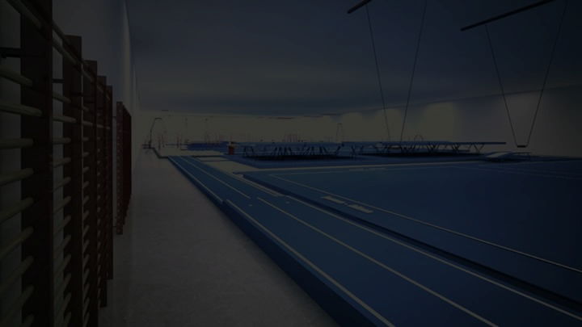



SPORTSPARK
Mumbai, INDIA
GYMNASTICS Apparatus Manufacturer & Distributor (Regd.)
GSTIN : 27ANPPC5094A1Z3
FOR ORDER – CONTACT
+91-9823313929 / +91-7020856923
sportsparkgym@gmail.com

Slide 2
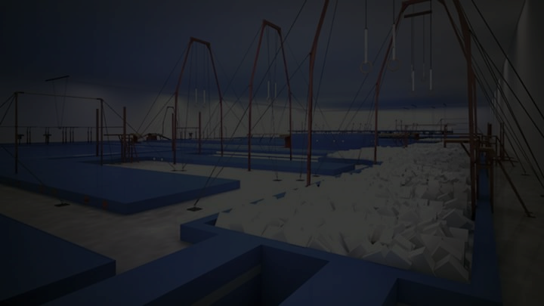
SPORTSPARK is super proud to announce that, we have started new wing - Gymnastics Apparatus Manufacturing, Distributing and supplying
We are specialized in GYMNASTICS and we have qualified team of experts having engineers. Our team, who has Gymnastics background and they all focuses on accuracy and safety of players. With maintaining protocols our equipments are designed technically ideal for professional use. We undertake responsibility of maintenance of equipments as well.
Salient Features of Company:
Technically Designed & Confirmed Standards
Maintaining High Quality & Advance Technology
Factory Rates Reasonable Prices
Customer Satisfaction & Warranty Support
Premium Quality

Slide 3
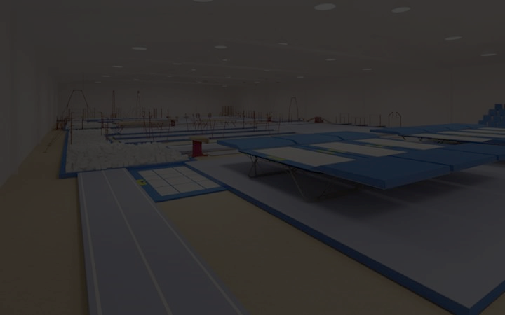
Mission
To provide full of safety to the all rising Gymnasts and aiming towards setting up with the professional infrastructure of Gymnastics Sport for creating best gymnasts in India. Our Moto is to improve the bars of Gymnastics in India with selling professional & specific (technically approved) Apparatus.
Service
Unlike other vendors who only know how to sell, SPORTSPARK gives satisfaction to customers and our support specialists will help you make the best possible decisions and will provide you with outstanding customer support, possible product information and guidance.
Post Delivery Service & Warranty Support
Our target is to give complete satisfaction to customers. SPORTSPARK’s is always ready to help Post Delivery Service, whether or not under guarantee: we will provide you information and complete assistance with any problems you encounter with your equipment.
5 Years Warranty on manufacturing defects *
Post Delivery Service Charges will be applicable extra.

Slide 4
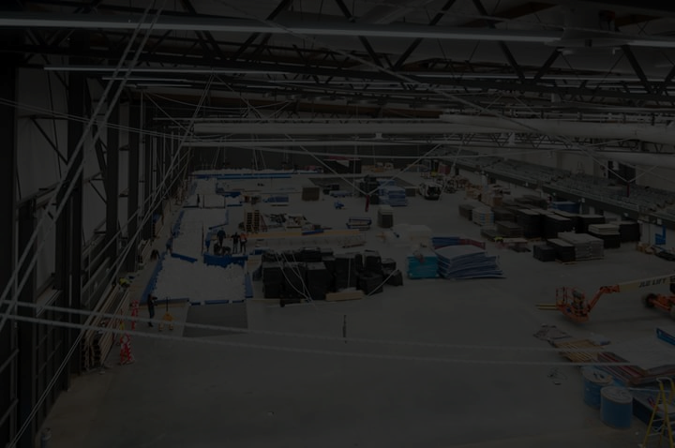
Terms & Conditions *
Additional transportation cost will be applicable.
18% GST will be applicable (9% SGST) & (9% CGST), (GST Under composition scheme)
Apparatus are for Indoor use only
75 % Advance Payment is mandatory with approved official purchase order / work order
Installation Charges will be extra on selective apparatus.
Balance Payment shall be made immediately on Delivery of Products (Within 7 Days)

Slide 5
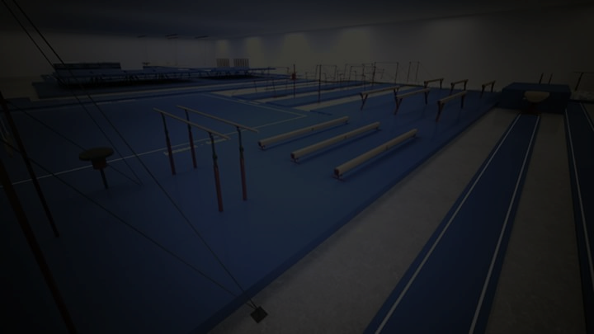
Installation Service –
SPORTSPARTK Provides Installation Service. We will install your equipment putting your facilities among the best available. Installation charges for following apparatus will be applicable. (Still Rings / Uneven Bars / High Bar / Flex Floor Exercise)
Domestic (Mumbai) Charges: Rs. 2000/- Only
Other Cities (Within Maharashtra): - Rs. 3500/- Only
Other States: - Rs. 8000/- Only

Slide 6
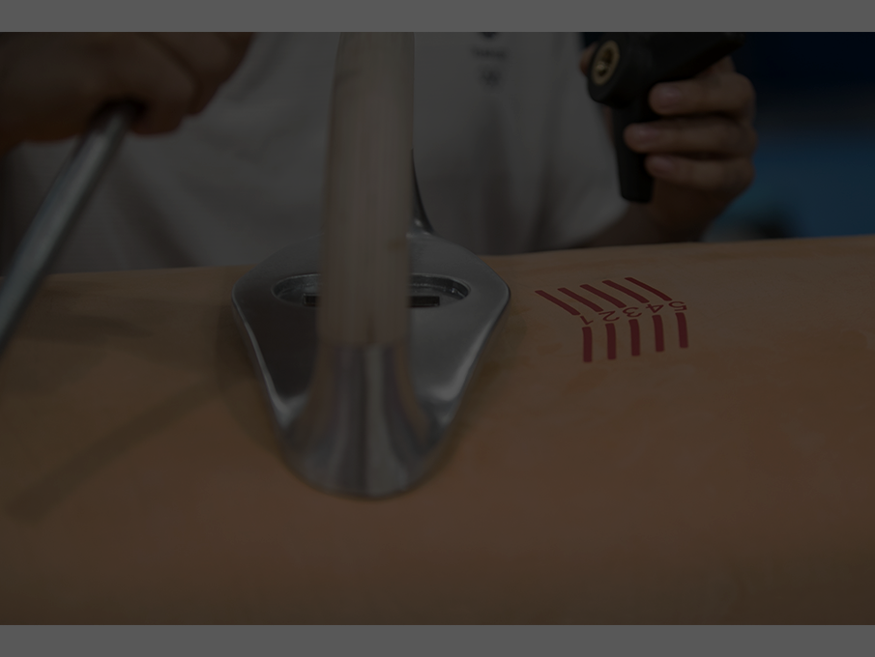
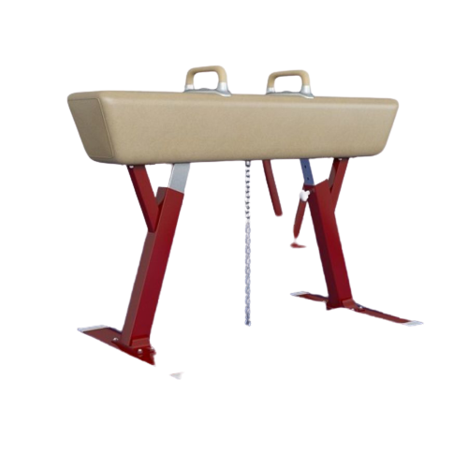
Pommel Horse
Standard Size – As per FIG Specification
FIG Specification Apparatus (Competitive Model)

Slide 7
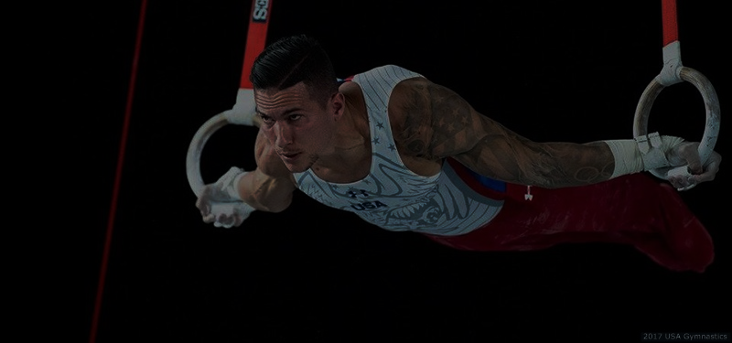
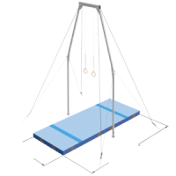
Still Rings
FIG Specification Apparatus (Competitive Model)
Standard Size – As per FIG Specification with Structure
Fiber Rings with sturdy belts.
Adjustable Structure made of pipes with tightening wire rope, Height adjustable, coupling etc.

Slide 8
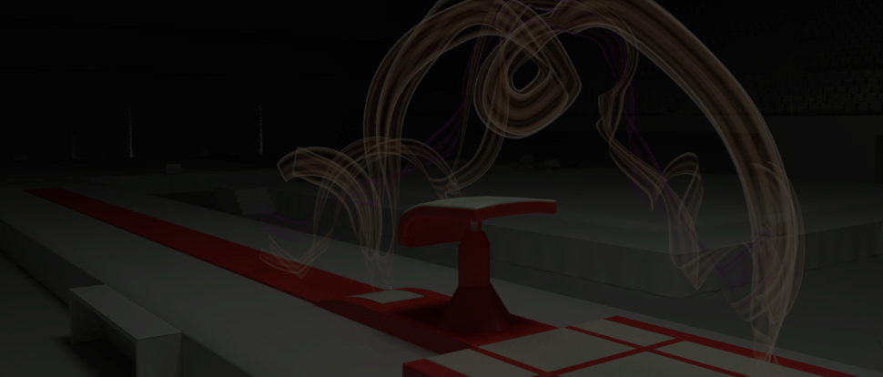
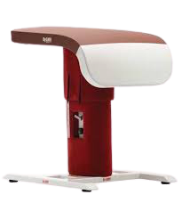
Table Vault
Standard Size – As per FIG Specification
FIG Specification Apparatus (Competitive Model)

Slide 9
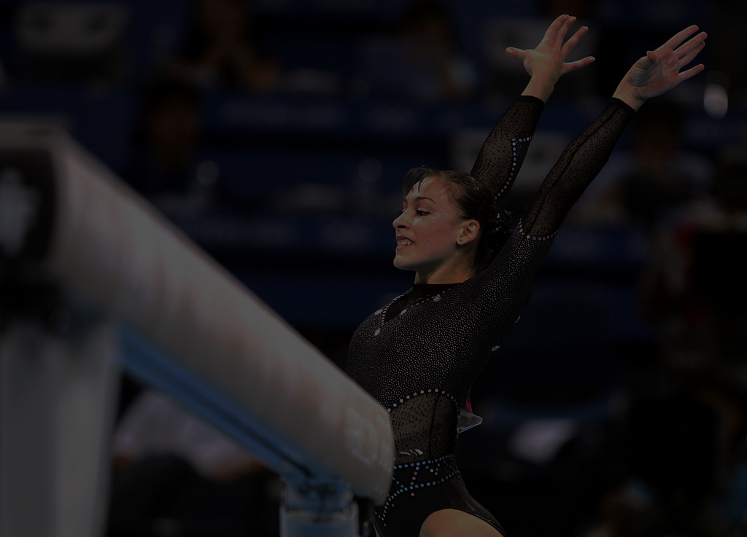
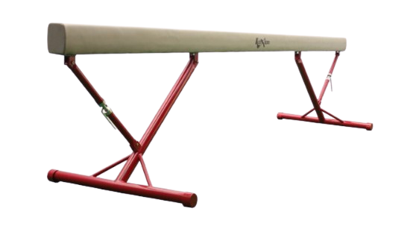
Balancing Beam
Standard Size – As per FIG Specification
FIG Specification Apparatus (Competitive Model)

Slide 10
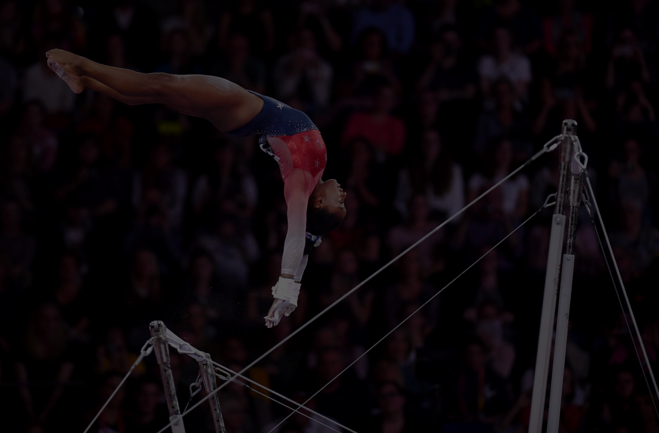
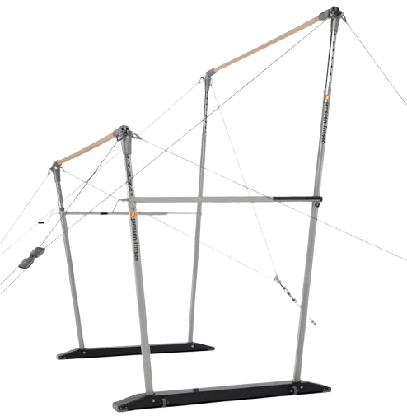
Uneven Bars
Standard Size – As per FIG Specification
FIG Specification Apparatus (Competitive Model)

Slide 11
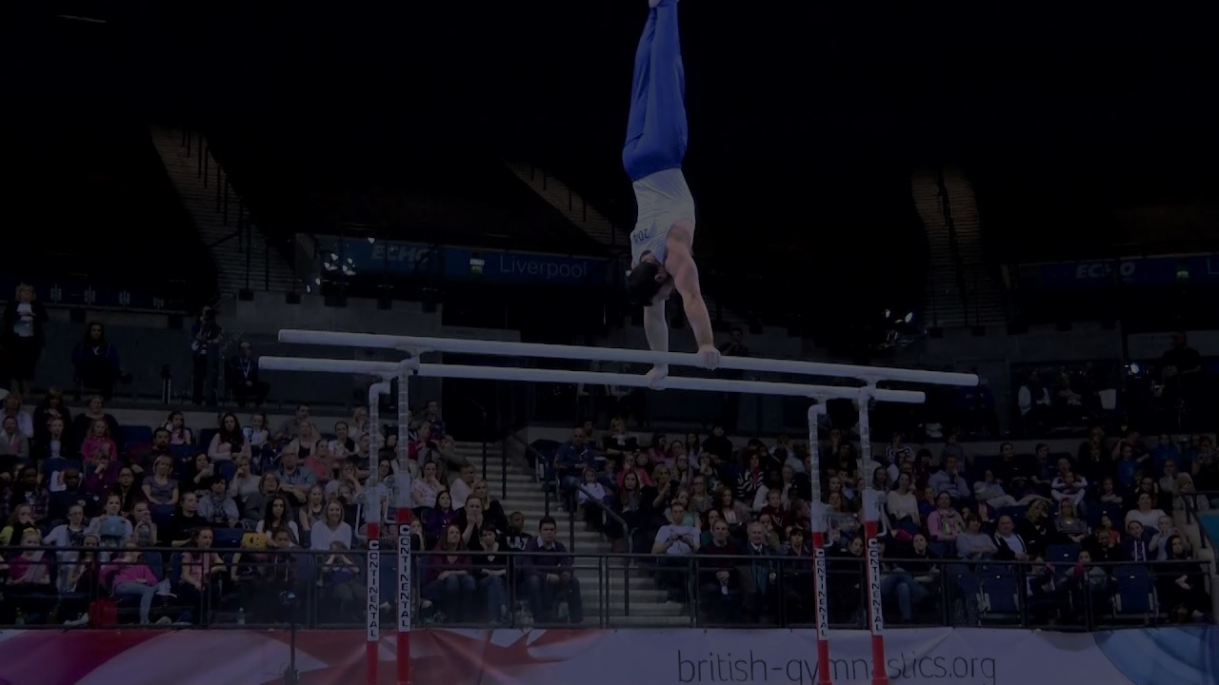
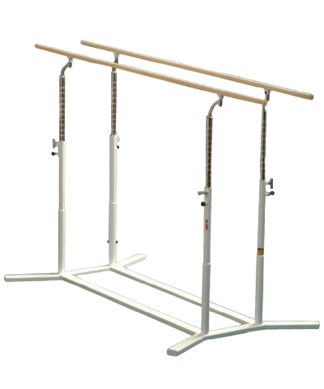
Parallel Bars
Standard Size – As per FIG Specification
FIG Specification Apparatus (Competitive Model)

Slide 12
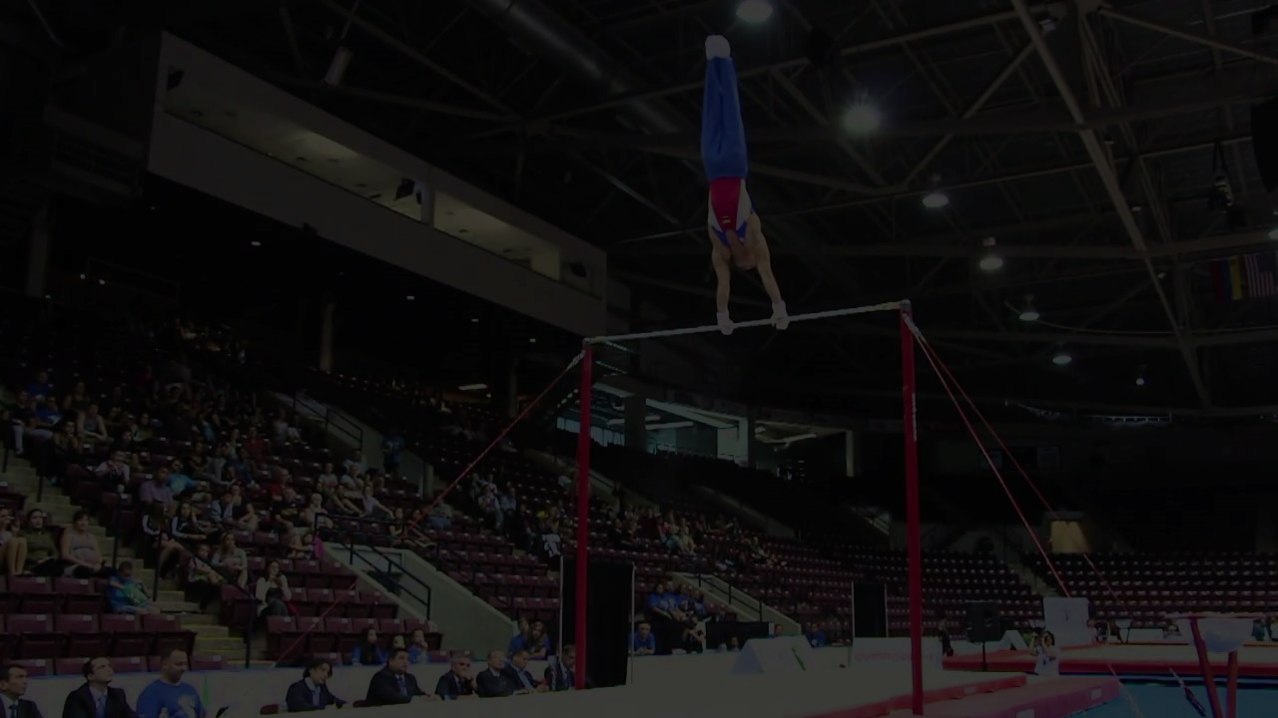
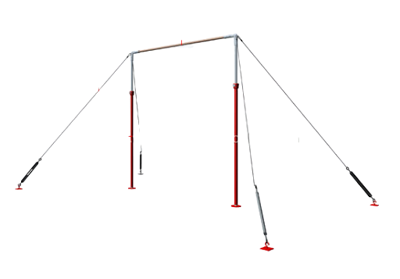
Horizontal Bar
Standard Size – As per FIG Specification
FIG Specification Apparatus (Competitive Model)

Slide 13
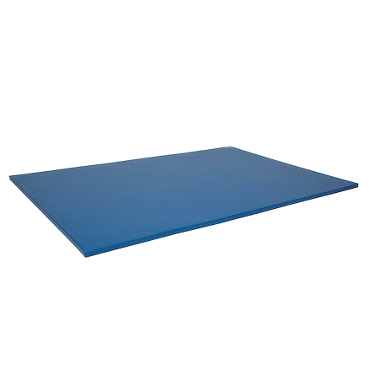
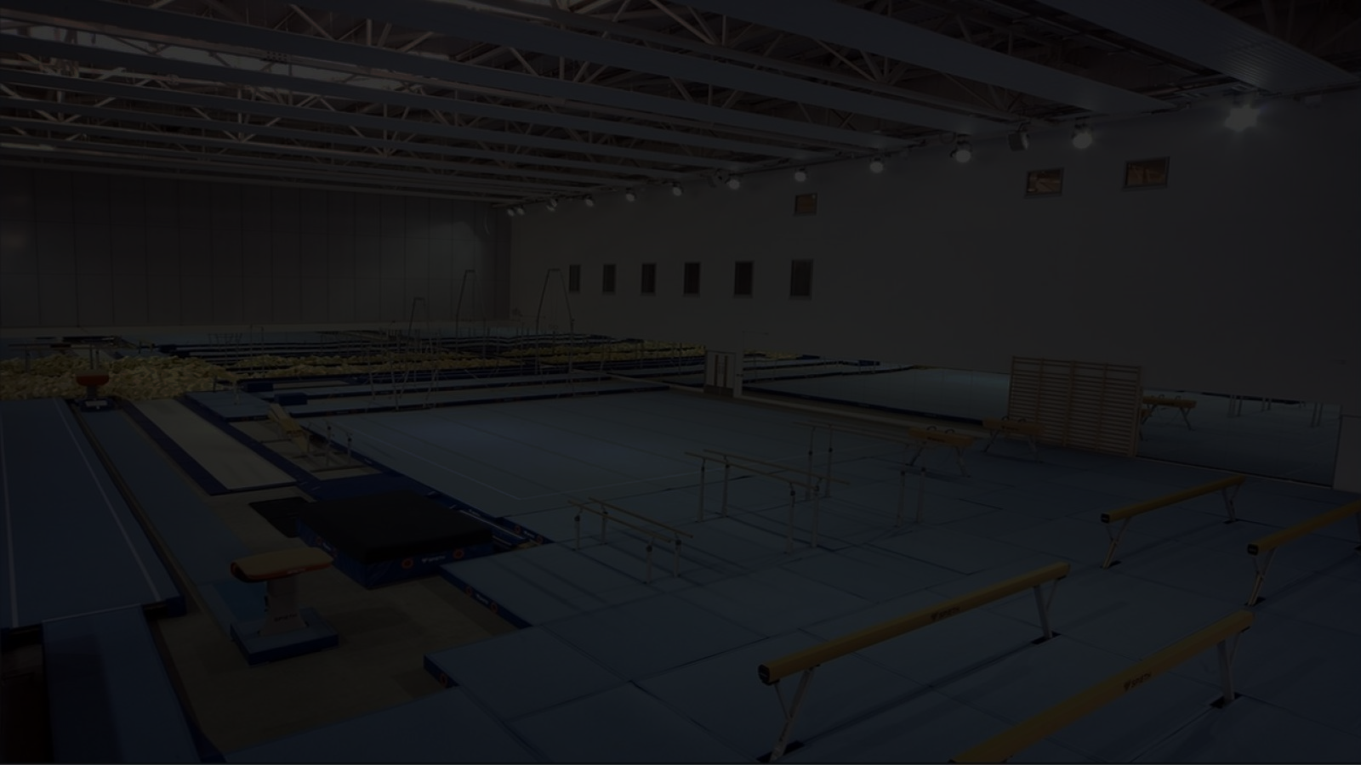
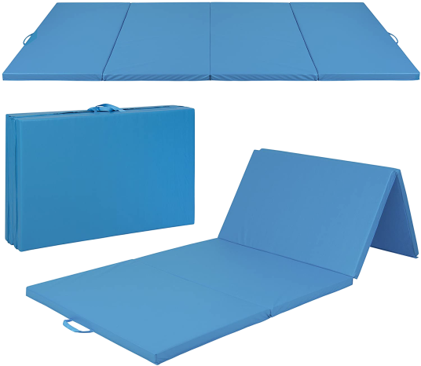
Gymnastics Mattress
Size: 6ft X 4ft X 50 mm with
Hitlon Material & Synthetic Cover (Washable)
Allied Apparatus (For Training Purpose / Training Aids)
Gymnastics Mattress (Folding One)
Size: 8ft X 4ft X 50 mm with
Hitlon Material & Synthetic Cover ( Folding Washable)
Allied Apparatus (For Training Purpose / Training Aids)

Slide 14
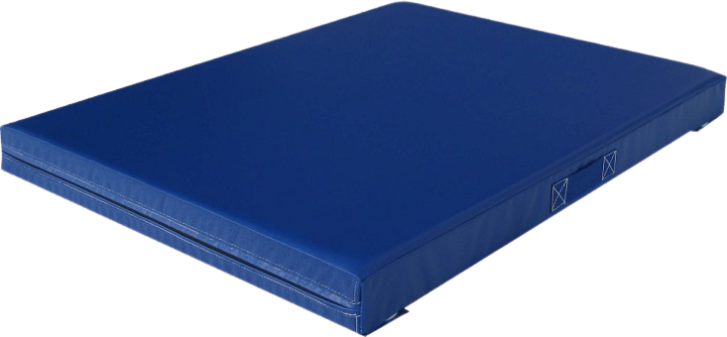

Crash Mat (Mini)
Size: 6 feet X 6 feet X 10 Inches Thickness in Size with Synthetic Cover (Washable)
Great stability and Shock absorption. Cover Made of strong PVC coated Nylon fabric.
Two Handles on both sides of the mat for easy carrying
Crash Mat (Standard Size)
Size: 9 feet X 6 feet X 1ft Thickness in Size with Synthetic Cover (Washable)
Great stability and Shock absorption. Cover Made of strong PVC coated Rexene Cover.
Two Handles on both sides of the mat for easy carrying

Slide 15
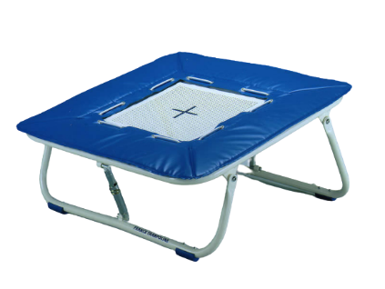
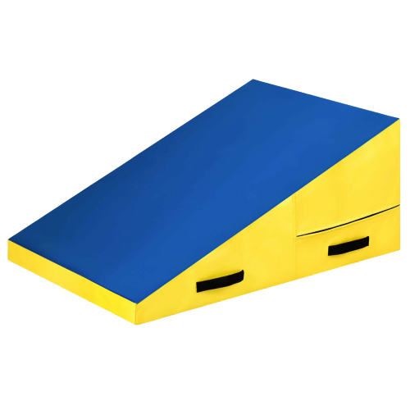
Trampoline (For Practice Purpose)
0.8 mtr X 0.8 mtr Square shape with four side power springs
covered with foam & Hitlon non slippery top,
Non – Tearing Cover (Adjustable Height)
Cheese Mat
(Incline Support)
Allied equipment/ like Spring Board Shape- Incline Support
Covered with Non tearing PVC Coated Rexene Cover (Washable)

Slide 16
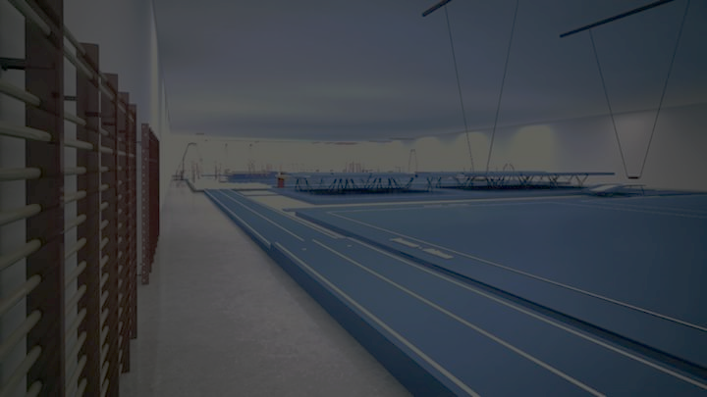
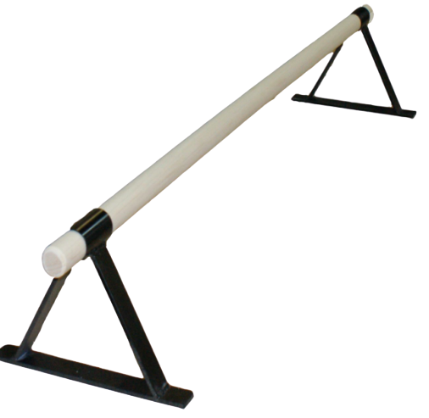
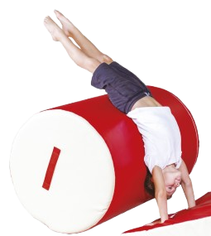
Baby Bars
Ground Parallel Bars (Width Adjustable)
Made up of Metals with triangular surface support
Cylindrical Foam Drum
Allied Apparatus - Drum Foam With hitlon synthetic cover
Cylindrical shape ( Gymnastics Training Aid)

Slide 17
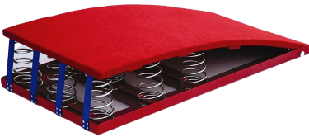
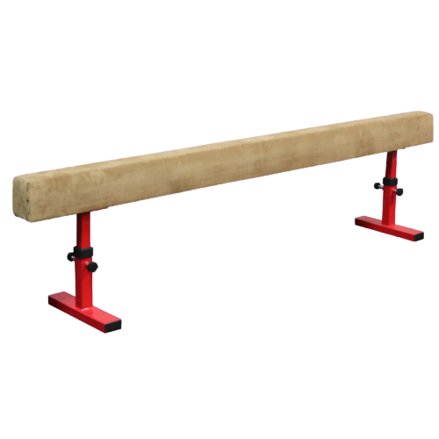
Spring Board
Arena Wooden spring board, covered with the non-tearing &
non slippery cushion with five heavy duty iron Springs.
Balancing Beam –
For Training Purpose
Training Purpose – Height 1 feet X 10 feet in length. Allied Apparatus

Slide 18
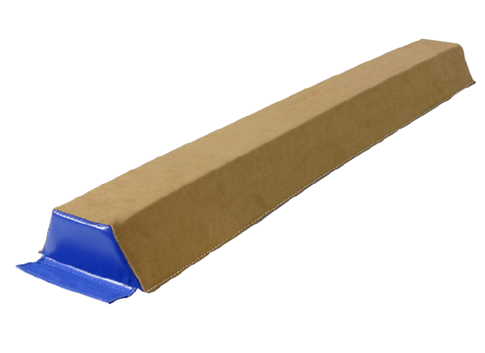
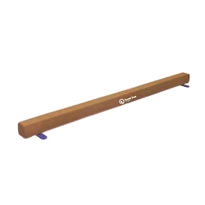
Ground Level Balancing Beam (Foam) –
For Training Purpose
Basics Skills improvements – Size base 8 Inches, Height 6 Inches & top 6 Inches 9 feet in length
Ground Level Balancing Beam –
For Training Purpose
Training Purpose – Width 4 inches X 9 feet in length.
Allied Apparatus

Slide 19
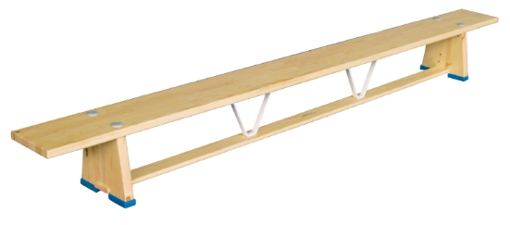
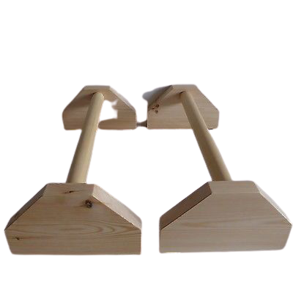
Bench Beam -
Training Purpose – Height 1 feet X 9 feet in length. Allied Apparatus
Baby Bars (Wooden) -
Ground Parallel Bars (Width Adjustable)
Made up of wooden with square surface support

Slide 20
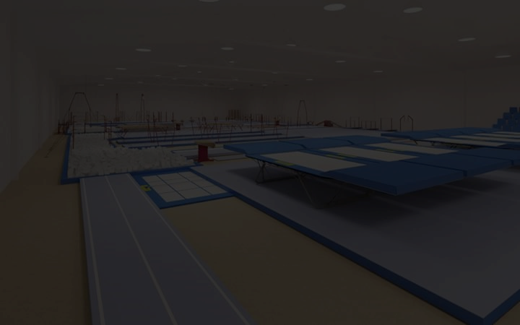
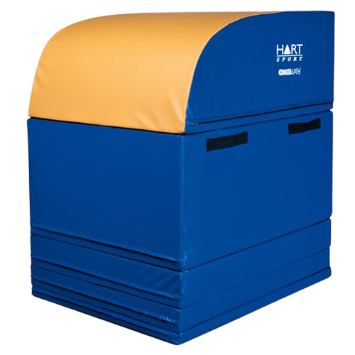
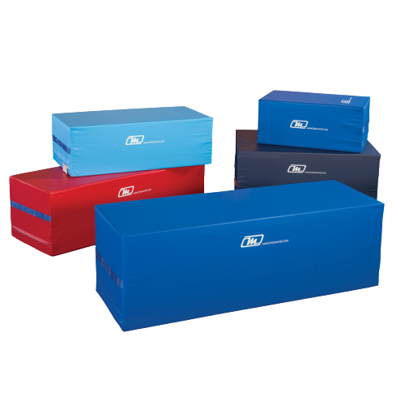
Foam Box Vaulting Table
(Foldable / Adjustable)
Size 95 cm X 120 cm X 135 cm (Four boxes attached with Velcro)
Foam Blocks
Length 39 Inches width 27 Inches Height 12 Inches

Slide 21
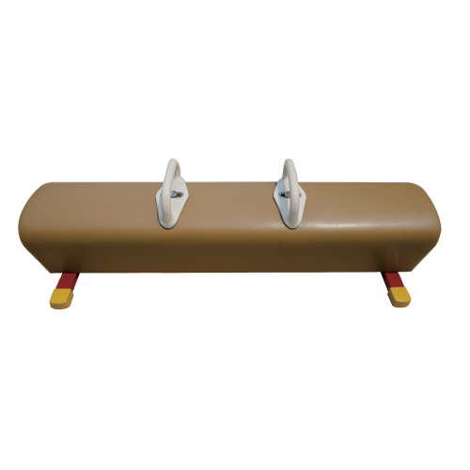
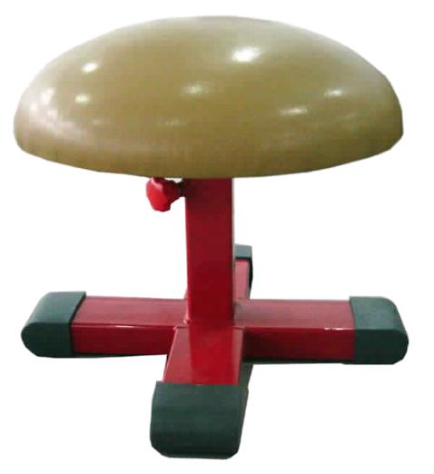
Ground Level Pommel Horse
Floor level, Covered with non tearing synthetic cover, Wooden Handles, for training purpose
Mushroom Horse
Size – 1 Meter (diameter) Covered with non-slippery and non – tearing cushion.

Slide 22
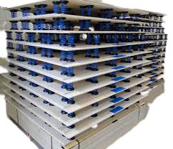
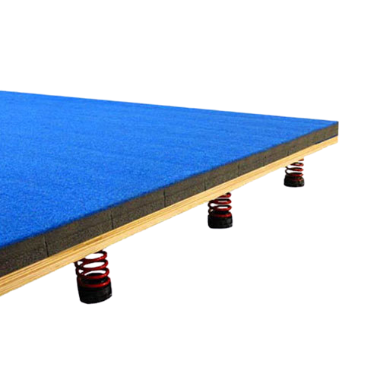
Flex Board
Without foam and carpet
Flex Board
With foam and carpet

Slide 23
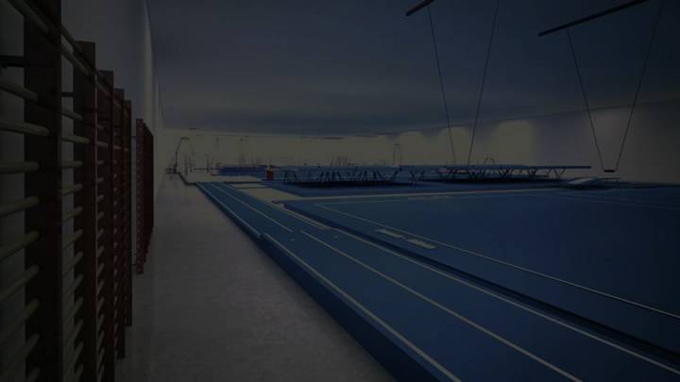
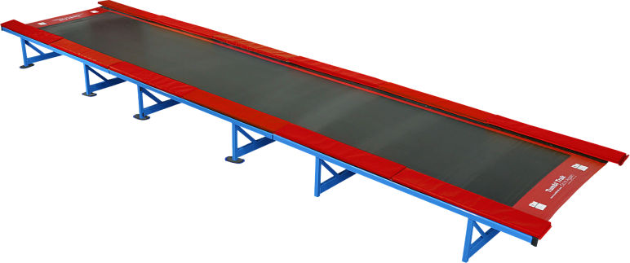
Trampoline Tumbling Track
1. Size – 20 ft X 6 ft X 2 ft
2. Size – 12 ft X 6 ft X 2 ft
3. Size – 6 ft X 6 ft X 2 ft

Slide 24
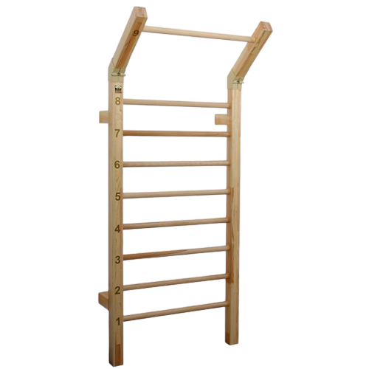
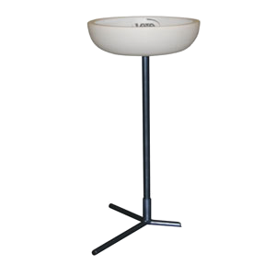
Wall Bar
Wall fitted Bars
Powder Stand

