Slide 1
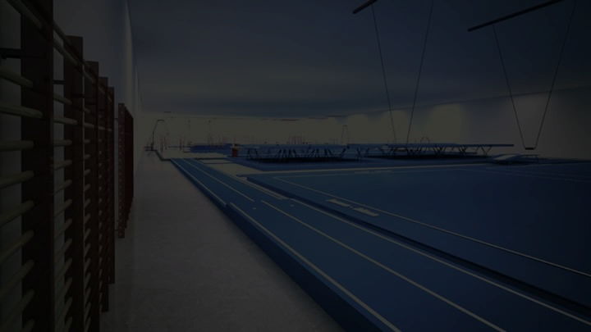



SPORTSPARK
www.sportsparkpro.com
Mumbai, INDIA
Kids Gym/Fitness Foam Apparatus Manufacturer & Distributor (Regd.)
GSTIN : 27ANPPC5094A1Z3
Official Exporter
FOR ORDER – CONTACT
+91-9823313929 / +91-7020856923
sportsparkgym@gmail.com

Slide 2
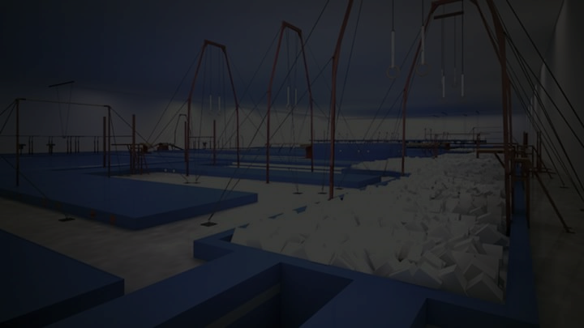
SPORTSPARK is super proud to announce that, we have started new wing –
Kids Gym/Fitness Foam Apparatus Manufacturing and Distributing.
We are specialized in GYMNASTICS & KIDS SPORTING FITNESS PROGRAM and we have qualified team of experts having engineers. Our team, who has Gymnastics & Sports background and they all focuses on accuracy and safety of players/Kids. With maintaining protocols our equipments are designed technically ideal for professional use. We undertake responsibility of maintenance of equipments as well.
Salient Features of Company:
Technically Designed & Confirmed Standards
Maintaining High Quality & Advance Technology
Maintaining Raw Material Standards
Factory Rates /Reasonable Prices
Customer Satisfaction / Warranty Support

Slide 3
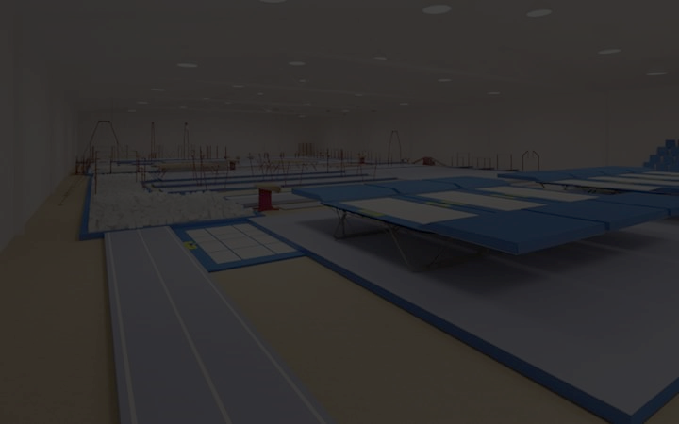
Mission
To provide full of safety to the all rising Kids and aiming towards setting up with the professional infrastructure of Kids Gym/Fitness for creating best & fit youth Globally. Our Moto is to improve the bars of Kids Fitness Globally with selling professional & specific (technically approved) Apparatus.
Service
Unlike other vendors who only know how to sell, SPORTSPARK gives satisfaction to customers and our support specialists will help you make the best possible decisions and will provide you with outstanding customer support, possible product information and guidance.
Post Delivery Service
Our target is to give complete satisfaction to customers. SPORTSPARK’s is always ready to help Post Delivery Service, whether or not under guarantee: we will provide you information and complete assistance with any problems you encounter with your equipment.
Post Delivery Service Charges will be applicable extra.
5 Years warranty support on manufacturing defects.

Slide 4
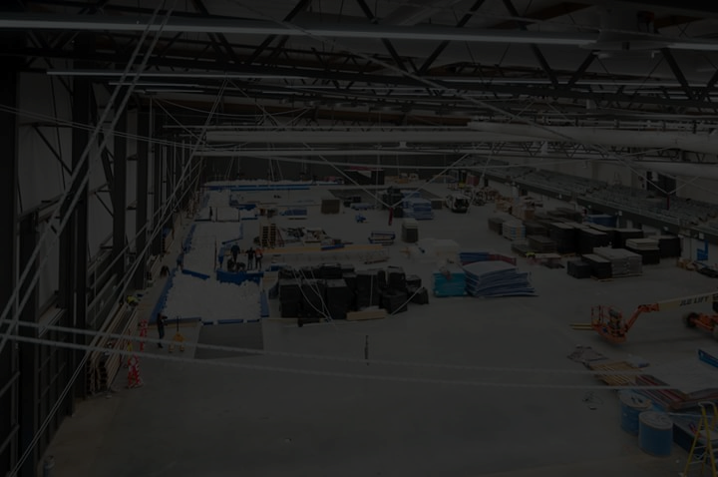
Terms & Conditions *
Additional transportation cost will be applicable.
Export Duty/Tax will be applicable. (For Exports)
Domestic - 18% GST will be applicable (9% SGST) & (9% CGST) & 7 % VAT Applicable.
Bear in mind that your card issuer may charge you a foreign transaction fee.
Apparatus are for Indoor use only
75 % Advance Payment is mandatory with approved official purchase order / work order
Installation Charges will be extra on selective apparatus.
Balance Payment shall be made immediately on Delivery of Products (Within 7 Days)

Slide 5
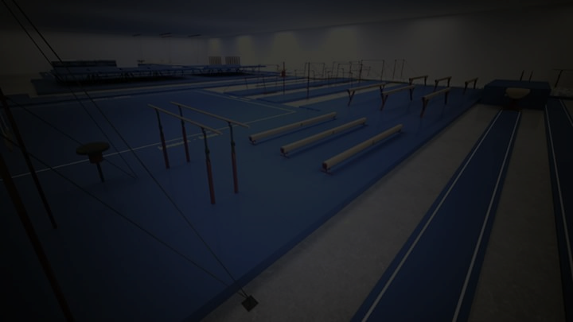
Installation Service –
SPORTSPARTK Provides Installation Service. We will install your equipment putting your facilities among the best available. Installation charges for following apparatus will be applicable. (Entire Set up)
Domestic/Inter States– Applicable as per the plan
International Setup Charges – Flight Return Ticket (2 Persons) + Visa + Rs. 30,000/- Only

Slide 6
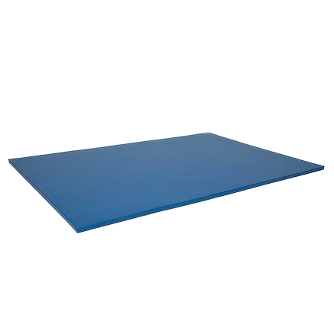
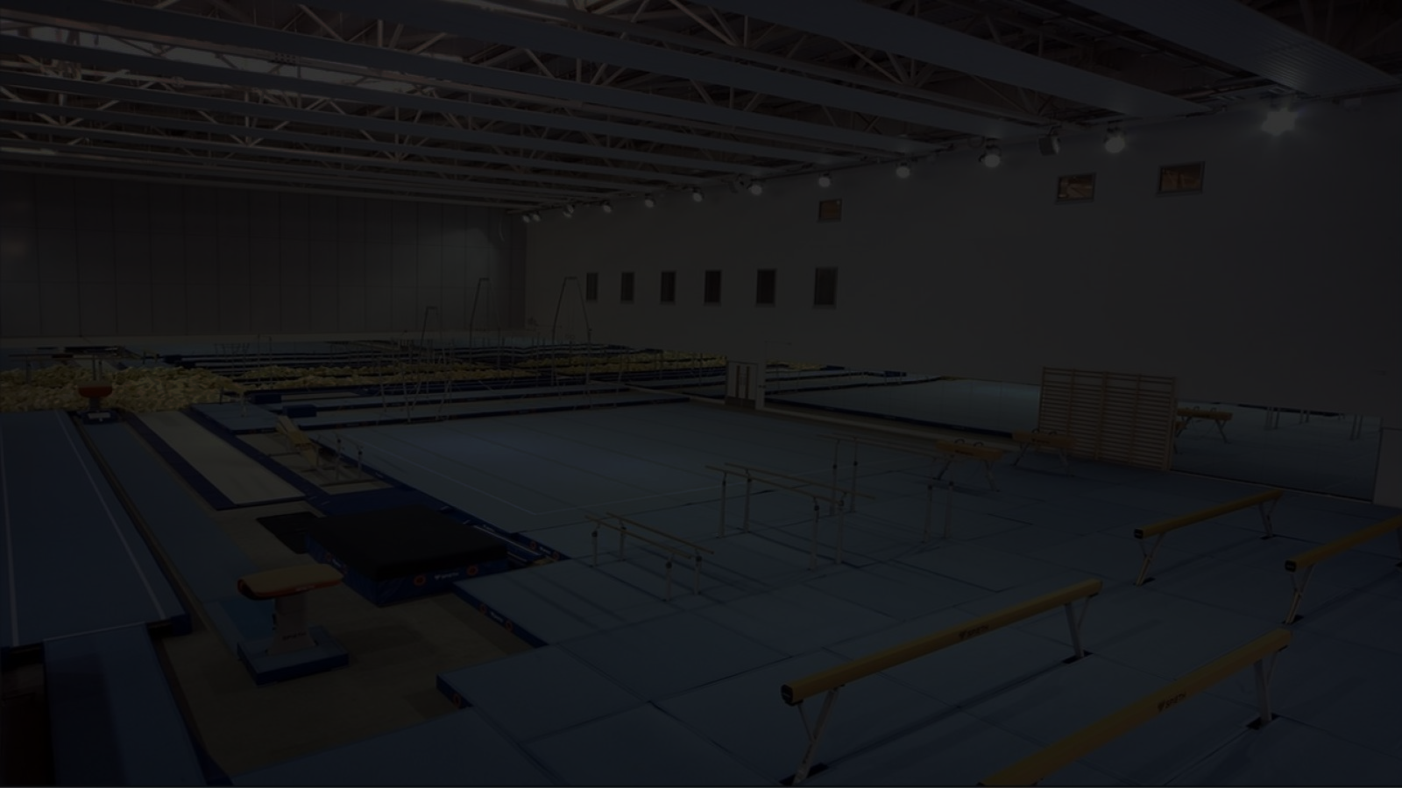
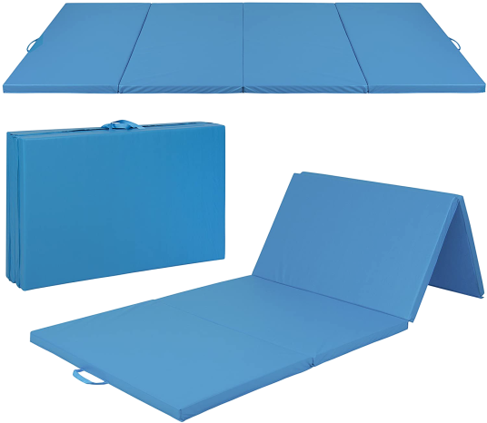
Gymnastics/Fitness Mattress
Size: 6ft X 4ft X 50 mm with
Hitlon Material & Synthetic PVC Cover (Washable)
Allied Apparatus (For Training Purpose / Training Aids)
Gymnastics Mattress (Folding One)
Size: 8ft X 4ft X 50 mm with
Hitlon Material & Synthetic PVC Cover ( Folding Washable/3 Folds )
Allied Apparatus (For Training Purpose / Training Aids)

Slide 7
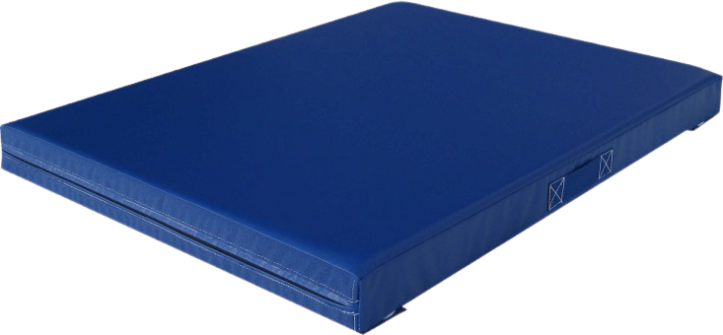
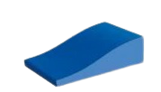
Crash Mat (Mini)
Size: 6 feet X 6 feet X 9 Inches Thickness in Size with Synthetic Cover (Washable)
Great stability and Shock absorption. Cover Made of strong PVC coated Nylon fabric.
Two Handles on both sides of the mat for easy carrying
Wave Slope (Wave Incline Mat)
Size: Length – 90 cm , Width – 60 cm & Height cm with Synthetic PVC Cover (Washable)
Great stability and Shock absorption. Cover Made of strong PVC coated Rexene Cover.

Slide 8
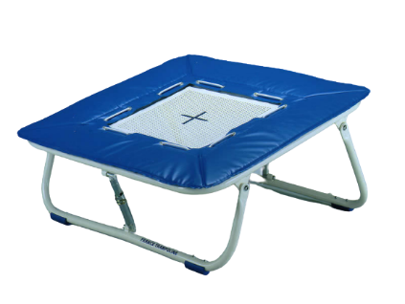
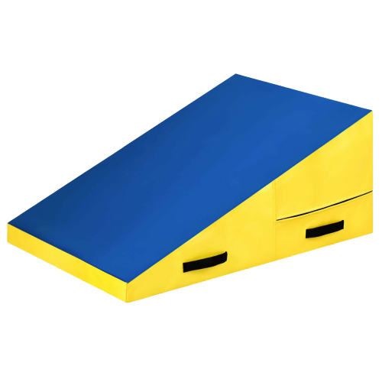
Trampoline (For Practice Purpose)
0.8 mtr X 0.8 mtr Square shape with four side power springs
covered with foam & Hitlon non slippery top,
Non – Tearing Cover (Adjustable Height)
Cheese Mat
(Incline Support)
Allied equipment/ like Spring Board Shape- Incline Support
Covered with Non tearing PVC Coated Rexene Cover (Washable)

Slide 9
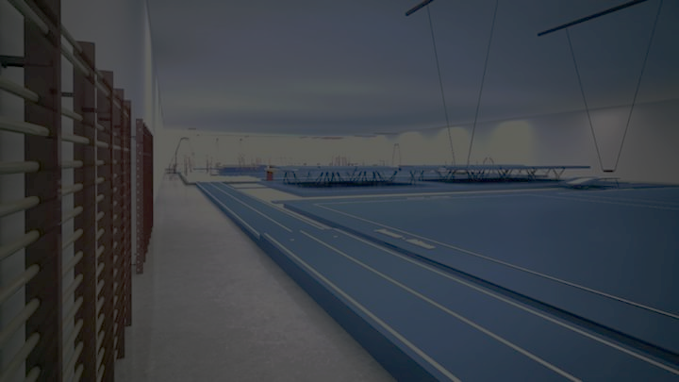
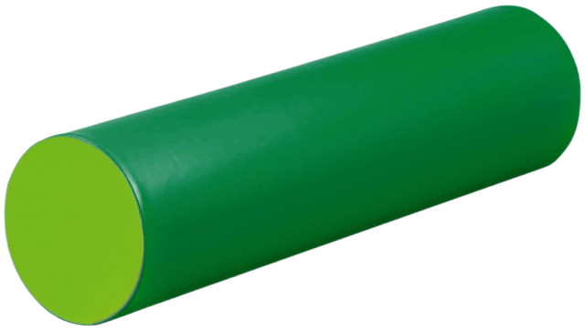
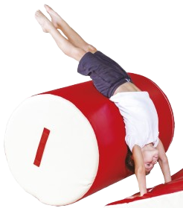
Long Foam Cylindrical Foam Drum
Length – 120 cm & Diameter – 30 cm
Allied Apparatus - Drum Foam With hitlon synthetic PVC cover
Cylindrical Foam Drum
Allied Apparatus - Drum Foam With hitlon synthetic PVC cover
Cylindrical shape ( Gymnastics Training Aid)

Slide 10


Long Foam Beam
Size – 245 cm & 30 cm & height 30 cm, covered with the non-tearing &
non slippery cushion
Size – 120 cm & 30 cm & height 30 cm, covered with the non-tearing & non slippery PVC Cover
U Shaped fitting block
Length – 60 cm, width – 30cm, Height / Inside – 30 cm X 30 cm with the non – tearing & non slippery PVC Cover

Slide 11
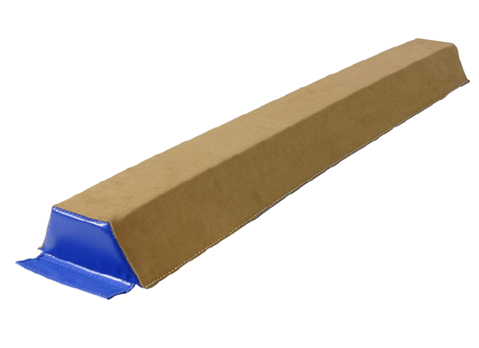
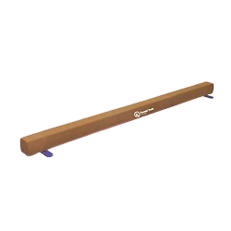
Ground Level Balancing Beam (Foam) –
For Training Purpose
Size – 300 cm & 20 cm & height 20 cm, covered with the non-tearing & non slippery PVC Cover
Ground Level Balancing Beam –
For Training Purpose
Size – 300 cm & 20 cm & height 20 cm, covered with the non-tearing & non slippery PVC Cover

Slide 12
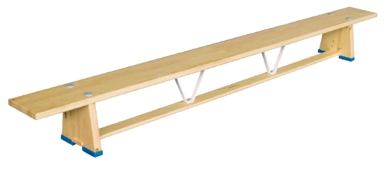
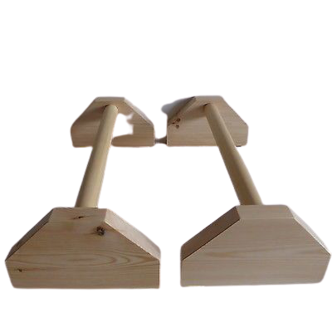
Bench Beam -
Training Purpose – Height 1 feet X 9 feet in length. Allied Apparatus
Baby Bars (Wooden) -
Ground Parallel Bars (Width Adjustable)
Made up of wooden with square surface support

Slide 13
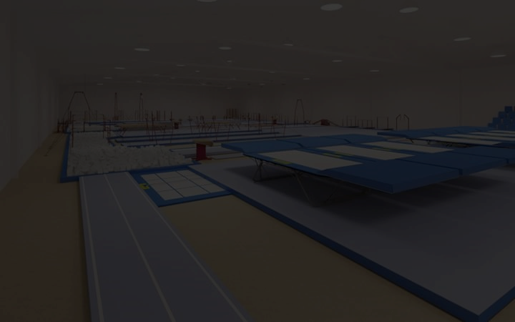
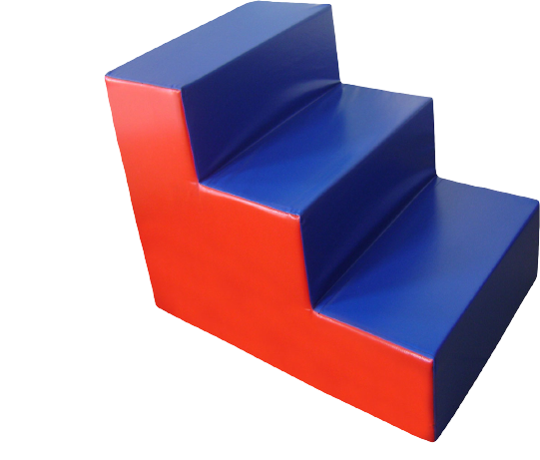
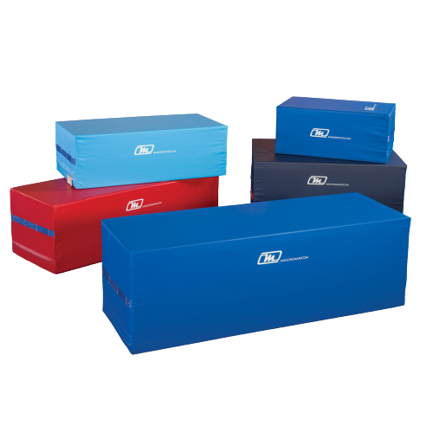
3 Stepper Mat
Size Length – 60 cm , Width – 60 cm & Height – 10 cm step
Foam Block
Length 39 Inches width 27 Inches Height 12 Inches

Slide 14
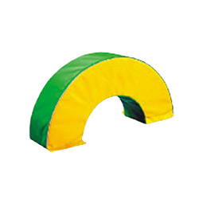
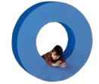
Semi Circle
Size – Diameter – 120 cm , Width – 30 cm &
Inner Diameter – 60 cm with best quality Rexene cover (Washable)
Full Big Circle
Size – Diameter – 120 cm , Width – 30 cm &
Inner Diameter – 60 cm with best quality Rexene cover (Washable)

Slide 15
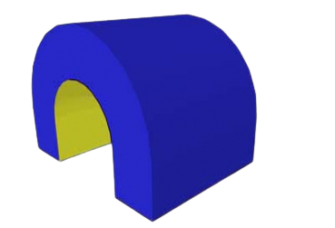

Tunnel
Length – 80 cm, width – 60 cm, height – 60 cm & Crawl Space – 40 cm
Oblique Shaped fitting block
Size – Length – 60 cm, Width – 30 cm, Height – 60 cm
Inside – 30 cm, X 30 cm & Diameter – 30 cm

Slide 16

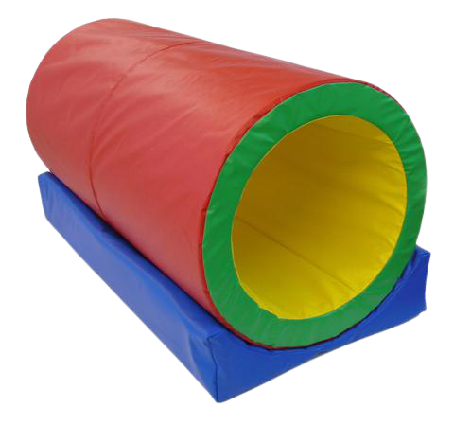
Beam & Cylinder fitting block
Length – 60 cm, Width – 30 cm, Height – 30 cm & Diameter – 20 cm
Barrel Foam
Length – 60 cm, Diameter – 60 cm, Inside Diameter – 40 cm

Slide 17
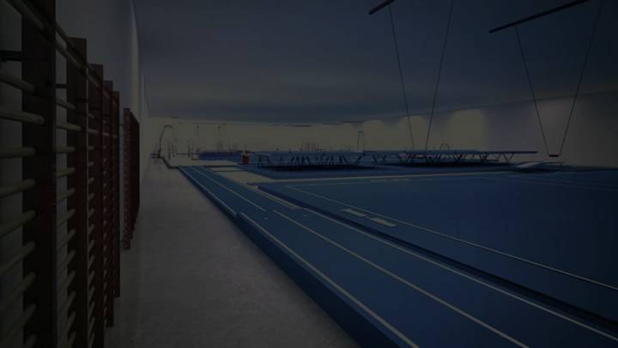


Beam and Cylinder fitting block
Size – Length – 60 cm, Width – 30cm, Height – 30cm,
Inside – 30 cm X 15 cm
Beam Curved
Size – Length – 120 cm, Width – 30 to 40 cm

Slide 18
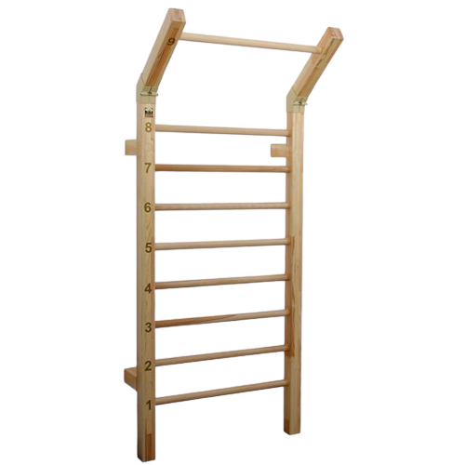
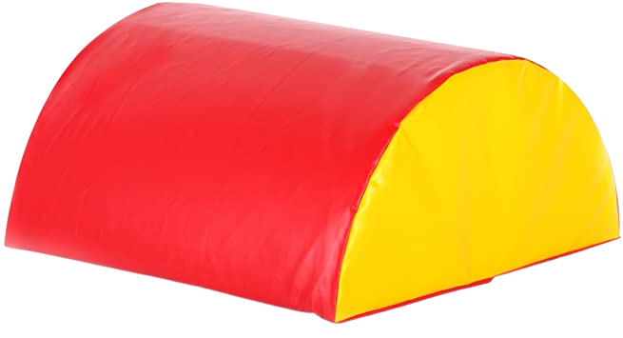
Wall Bar
Wall fitted Bars
Half Moon
L-120 cm, H-30 cm, Dia-60 cm

