Slide 1
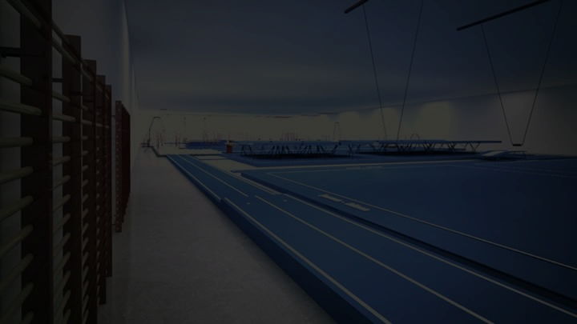



SPORTSPARK
www.sportsparkpro.com
Mumbai, INDIA
GYMNASTICS Apparatus Manufacturer & Distributor (Regd.)
Safety & Security Landing Mats/Flooring
Official Exporter
FOR ORDER – CONTACT
+91-9823313929 / +91-7020856923
sportsparkgym@gmail.com
GSTIN : 27ANPPC5094A1Z3

Slide 2
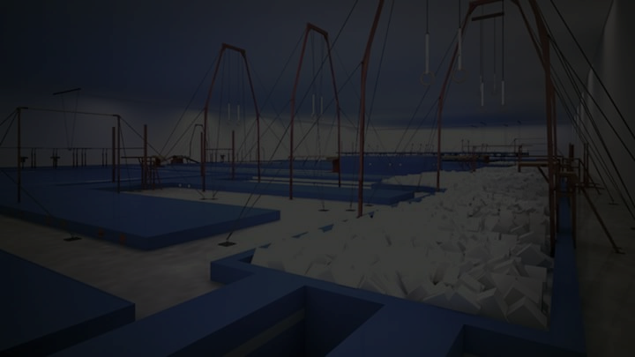
SPORTSPARK is super proud to announce that, we have started new wing –
GYMNASTICS Apparatus & Safety – Security Landing Mats/Flooring Manufacturing and Distribution
We are specialized in GYMNASTICS & KIDS SPORTING FITNESS PROGRAM and we have qualified team of experts having engineers. Our team, who has Gymnastics & Sports background and they all focuses on accuracy and safety of players/Kids. With maintaining protocols our equipments are designed technically ideal for professional use. We undertake responsibility of maintenance of equipments as well.
Salient Features of Company:
Technically Designed & Confirmed Standards
Maintaining High Quality & Advance Technology
Maintaining Raw Material Standards
Factory Rates /Reasonable Prices
Customer Satisfaction / Warranty Support

Slide 3
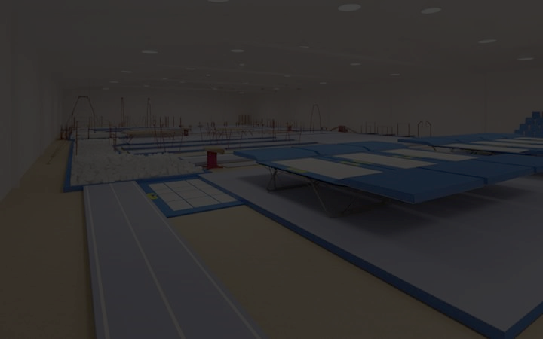
Mission
To provide full of safety to the all rising Kids and aiming towards setting up with the professional infrastructure of Kids Gym/Fitness for creating best & fit youth Globally. Our Moto is to improve the bars of Kids Fitness Globally with selling professional & specific (technically approved) Apparatus.
Service
Unlike other vendors who only know how to sell, SPORTSPARK gives satisfaction to customers and our support specialists will help you make the best possible decisions and will provide you with outstanding customer support, possible product information and guidance.
Post Delivery Service
Our target is to give complete satisfaction to customers. SPORTSPARK’s is always ready to help Post Delivery Service, whether or not under guarantee: we will provide you information and complete assistance with any problems you encounter with your equipment.
Post Delivery Service Charges will be applicable extra.
5 Years warranty support on manufacturing defects.

Slide 4
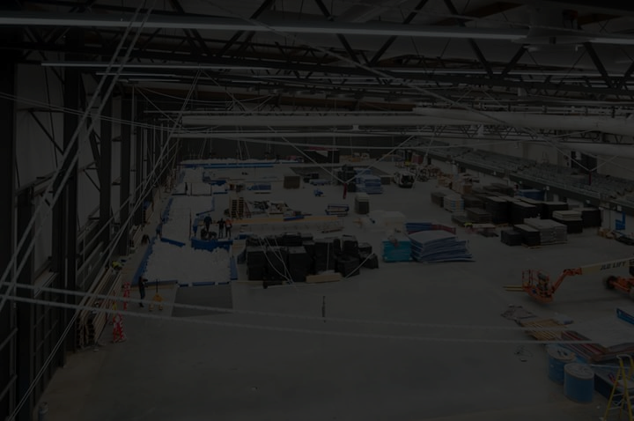
Terms & Conditions *
Additional transportation cost will be applicable.
Export Duty/Tax will be applicable. (For Exports) & 7 % VAT Applicable for exports
Domestic - 18% GST will be applicable (9% SGST) & (9% CGST).
Apparatus are for Indoor use only
75 % Advance Payment is mandatory with approved official purchase order / work order
Installation Charges will be extra on selective apparatus.
Balance Payment shall be made immediately on Delivery of Products (Within 7 Days)

Slide 5
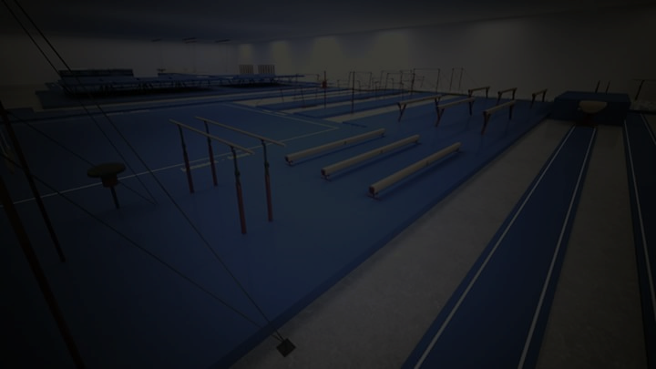
Installation Service –
SPORTSPARTK Provides Installation Service. We will install your equipment putting your facilities among the best available. Installation charges for following apparatus will be applicable. (Entire Set up)
Domestic/Inter States– Applicable as per the plan
International Setup Charges – Flight Return Ticket (2 Persons) + Visa + Rs. 30,000/- Only

Slide 6
Protect Your Gymnasts with High-Quality Safety and Landing Mats
Safety & Security Mats are specially designed to provide safe, shock absorbing surface to increase comfort during training in the event & reducing risk of injuries & allow gymnasts to practice or compete in complete safety.

Slide 7
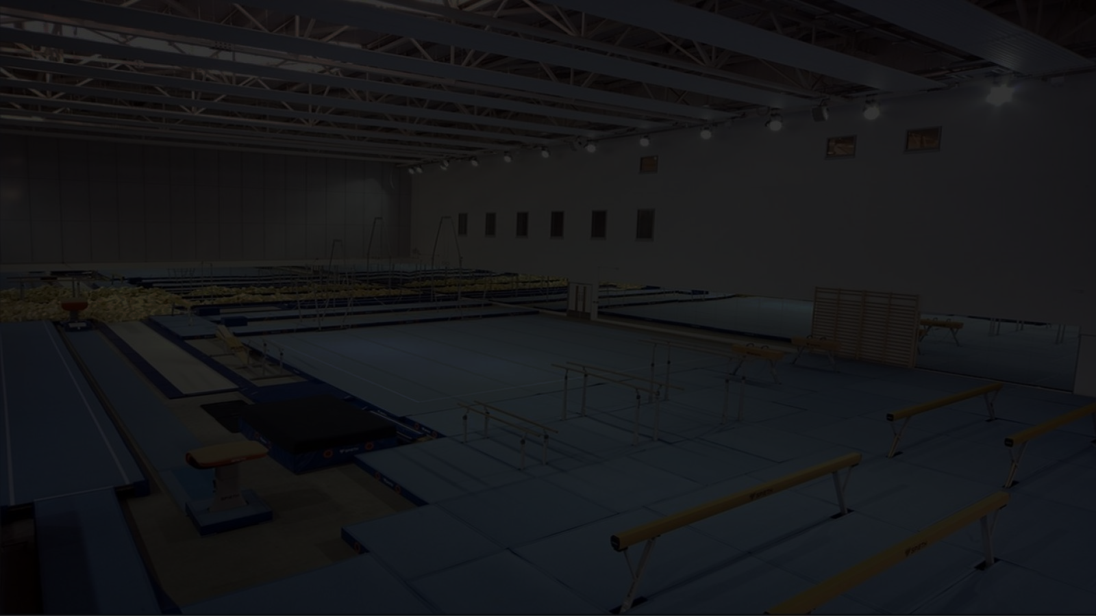
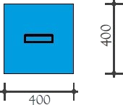
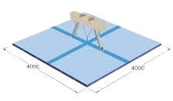
Pommel Horse
Pommel Horse Landing Mat 10 cm thickness
With Hi-tlon Material & Synthetic PVC Cover (Washable)
Extra Safety & Security Mat for Landing Mats/Flooring – 400 X 400
400
400

Slide 8
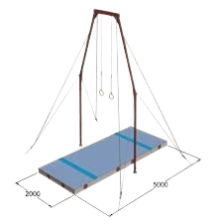
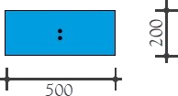
Still Rings
Still Rings (Roman Rings) Landing Mat 20 cm thick with Synthetic Cover (Washable)
Great stability and Shock absorption. Handles on both sides of the mat for easy carrying
Extra Safety & Security Mat for Landing Mats/Flooring – 500 X 200
200
500

Slide 9
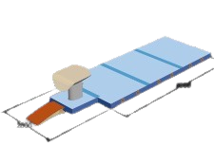
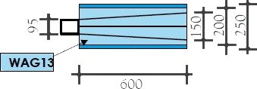
Vaulting Table
Vault Landing Mat 20 cm Thick. Great stability and Shock absorption
Extra Safety & Security Mat for Landing Mats/Flooring
95
150
200
250
600

Slide 10
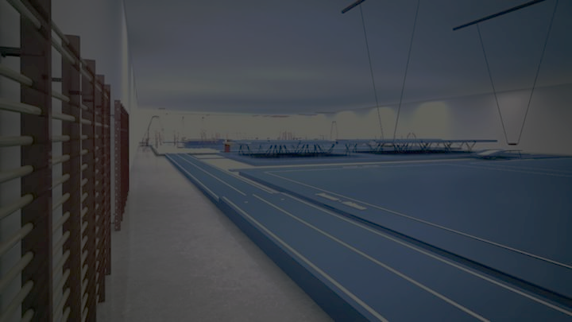
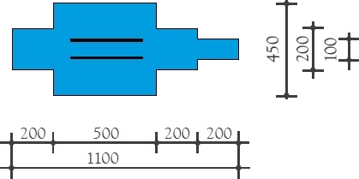
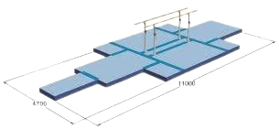
Parallel Bar
Parallel Bar Landing Mat 20 cm Thick with Hi-tlon Material & Synthetic PVC Cover (Washable)
Extra Safety & Security Mat for Landing Mats/Flooring
450
200
100
200
500
200
200
1100

Slide 11
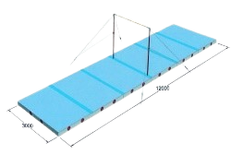
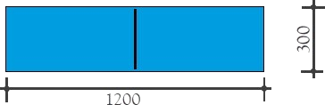
Horizontal Bar
Horizontal Bar 20 cm thickness with Hi-tlon Material & Synthetic PVC Cover (Washable)
Extra Safety & Security Mat for Landing Mats/Flooring – 1200 X 300
300
1200

